Slide 1
Network Devices

Slide 2
Network Devices
Modem
Converts between digital and analog
An example is a cable modem
Converts (both ways) the data
Translates incoming data from the cable
Translates data to be sent over cable
Router
Routes traffic from one network to another
Allows devices on a network to communicate

Slide 3
Network Devices
Access Point
How a devices connects to a router, switch, etc…
Can be wired or wireless
Switch
Filters and forwards network traffic
Follows pre-set protocols
Firewall
Barrier to protect network or system
Keeps out malicious traffic

Slide 4






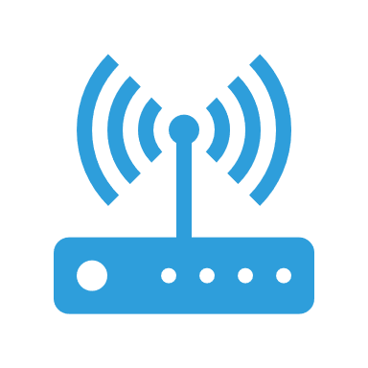


Network Devices
Example of a network
Internet Service Provider
Modem
Switch
Router
Firewall
Access Point

